Slide 1
Introduction to Java Virtual Machine

Slide 2
Overview
課程大綱
JavaVM
Java VM Model
ByteCodes
Addition Example
Java Example
How to make a Java VM
A Simple Java Virtual Machine
Experiment

Slide 3
課程大綱
第一周
介紹 JavaVM
實驗-自己動手做 JVM , 最後初步介紹 Java 與 Dalvik的關係
第二周
介紹 Dalvik 如何解析指令並回顧第一周重要內容
兩個實驗, 第一個編譯 Dalvik on X86
第三周
介紹 Java GC 與 Dalvik GC之機制

Slide 4
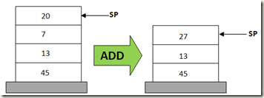
JavaVM
Java Virtual Machine
Stack-based (Last-In First-Out) Virtual Machine
Computation in Stack
Load Java ByteCode to execute program
Lines | Stack-based VM Pseudo Code
0 | POP 20
1 | POP 7
2 | ADD 20, 7, result
3 | PUSH result
http://www.codeproject.com/Articles/461052/Stack-based-vs-Register-based-Virtual-Machine-Arch

Slide 5
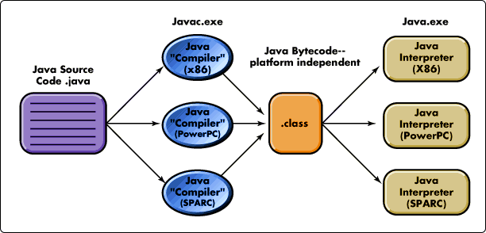
Java Source to ByteCode
http://javabook1.blogspot.tw/2013/07/introduction-to-java.html

Slide 6
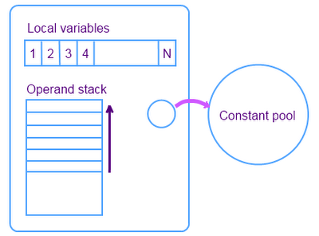
Java VM Model
Local Variables:
place the method input parameters
Operand Stack:
Computation Area
Put Instruction Operands and Return address
Constant Pool
Put Constant Data

Slide 7
ByteCodes
What is ByteCode ?
also known as p-code (portable code), is a form of instruction set designed for efficient execution by a software interpreter.
An Addition Example a = 20, b = 30
C-pseudo | X86 ASM | Java ByteCode (Human-syntax) | Java ByteCode binary
int add (int a, int b ) { return a+b; } | mov eax, byte [ebp-4] | iload_1 | 0x1a
 | mov edx, byte [ebp-8] | iload_2 | 0x1b
 | add eax, edx | iadd | 0x60
 | ret | ireturn | 0x3e

Slide 8
Addition Example
Local Variables
20
30
<<init>>
C-pseudo | Java ByteCode (Human-syntax)
void add (int a, int b ) { b = a+b; } | iload_1
 | iload_2
 | iadd
 | istore_2
An Addition Example a = 20, b = 30
Stack
Local Variables
20
30
Local Variables
20
30
Local Variables
20
30
Local Variables
20
50
0
1
2
Stack
20
Stack
20
30
Stack
50
Stack
50
iload_1
iload_2
iadd
istore_2

Slide 9
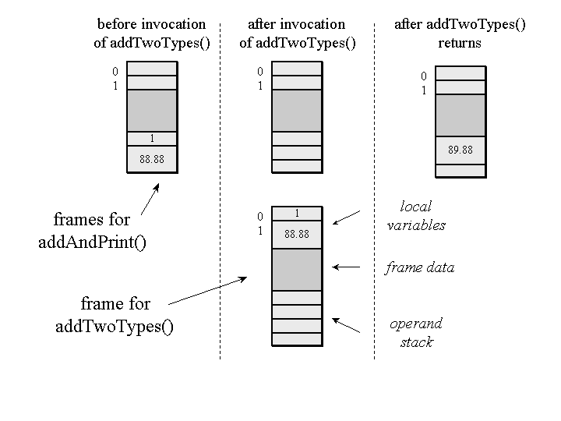
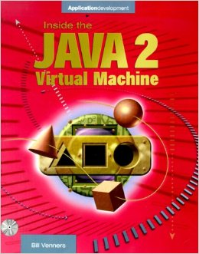
Java Example
class Example3c {
public static void addAndPrint() {
double result = addTwoTypes (1, 88.88);
System.out.println(result);
}
public static double addTwoTypes (int i, double d) {
return i + d;
}
}
Inside the Java Virtual Machine, 2000, Bill Venners

Slide 10
Java Bytecode instructions (Partials)
Mnemonic | Opcode | Stack
iadd | 0x60 | Pop value1, Pop value2 result = value1 + value2 Push result
isub | 0x64 | Pop value1, Pop value2 result = value1 - value2 Push result
idiv | 0x6C | Pop value1, Pop value2 result = value2 / value1 Push result
imul | 0x68 | Pop value1, Pop value2 result = value1 * value2 Push result
irem | 0x70 | Pop value1, Pop value2 result = value2 % value1 Push result
http://en.wikipedia.org/wiki/Java_bytecode_instruction_listings

Slide 11
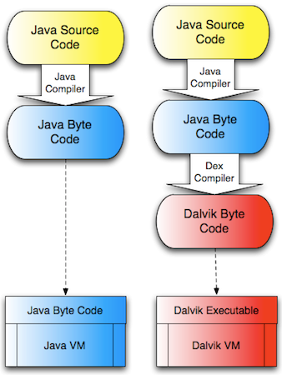
Java Translation for JVM and DVM

Slide 12
How to make a Java Virtual Machine
At least to know about Java Class File
Wikipedia
http://en.wikipedia.org/wiki/Java_bytecode
http://en.wikipedia.org/wiki/Java_class_file
the Java Specification
http://docs.oracle.com/javase/6/docs/index.html

Slide 13
Java Class file
Java Class File Structure
Magic Number: | 0xCAFEBABE
Version of Class File Format: | the minor and major versions of the class file
Constant Pool: | Pool of constants for the class
Access Flags: | for example whether the class is abstract, static, etc.
This Class: | The name of the current class
Super Class: | The name of the super class
Interfaces: | Any interfaces in the class
Fields: | Any fields in the class
Methods: | Any methods in the class
Attributes: | Any attributes of the class (for example the name of the sourcefile, etc.)

Slide 14
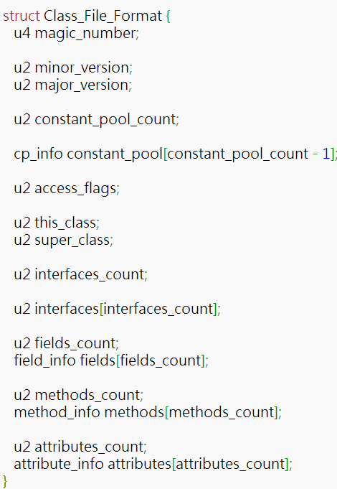
Java Class file Pseudo Data Structure

Slide 15
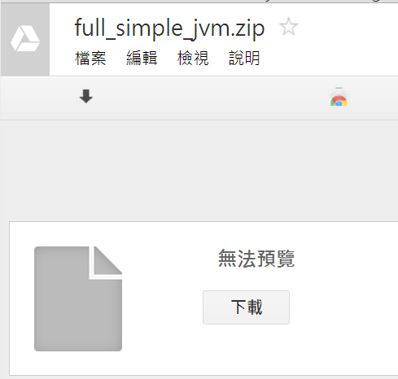
Download Simple JVM
goo.gl/FA3fwx

Slide 16
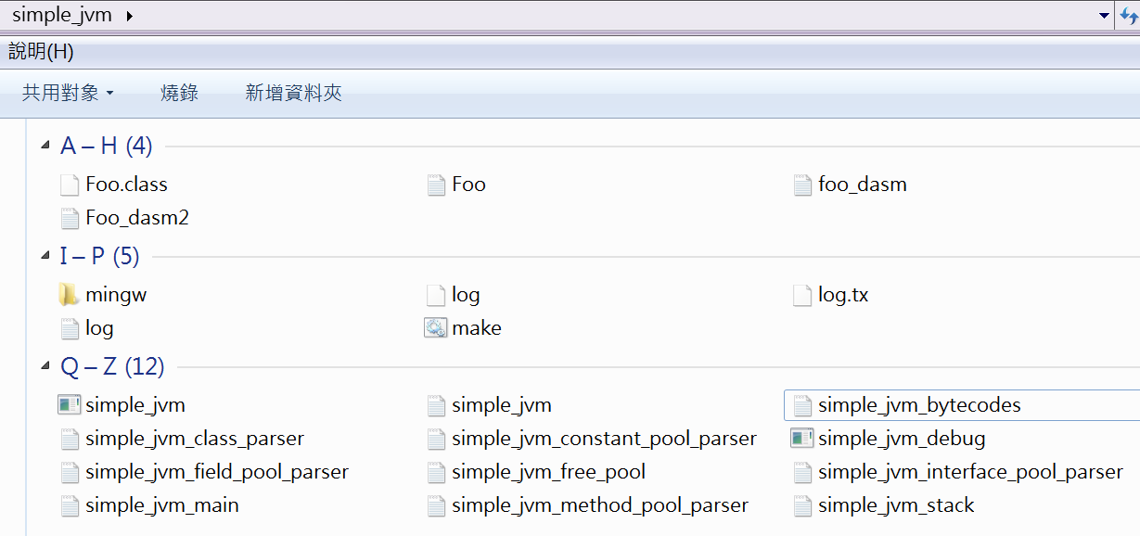
Simple JVM File Structure

Slide 17
Simple JVM
Constant Pool
Interface Pool
Stack
Method Pool
VM Engine ( Bytecode Loader)
Class File Parser

Slide 18
Simple JVM
Code Review

Slide 19
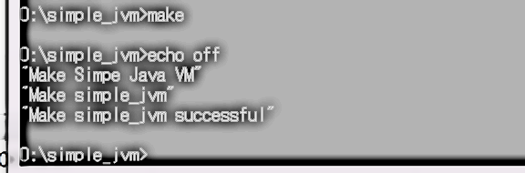
Compile Simple JVM

Slide 20
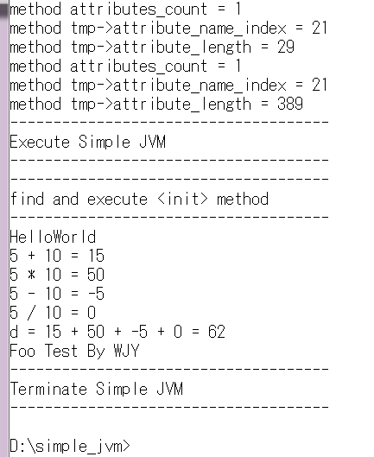
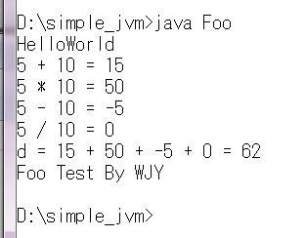
Test Foo
Java Foo
Simple JVM Foo

Slide 21
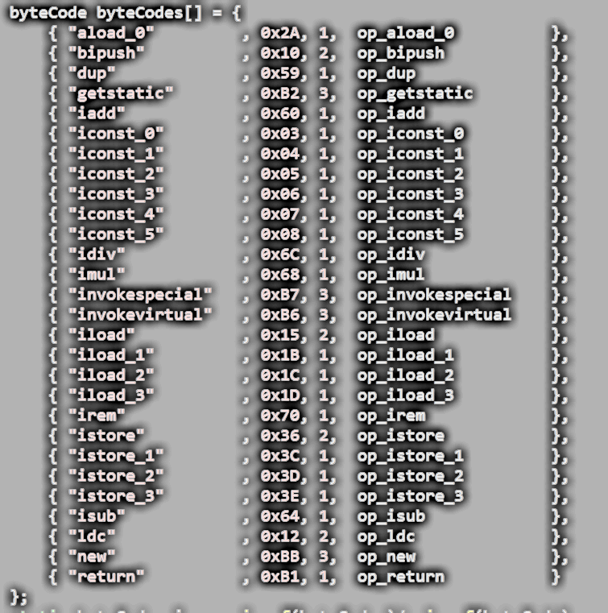
Simple JVM Instruction Table : simple_jvm_bytecodes.c

Slide 22
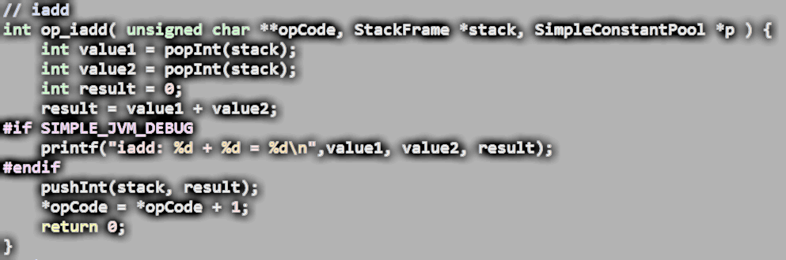
iadd : simple_jvm_bytecodes.c
iadd | 0x60 | Pop value1, Pop value2 result = value1 + value2 Push result

Slide 23
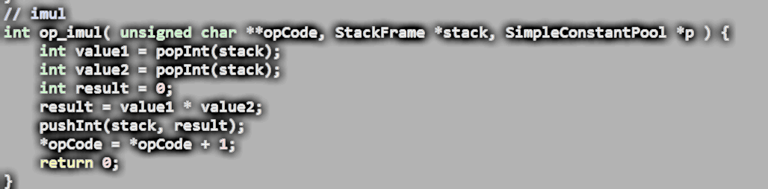
imul: simple_jvm_bytecodes.c
imul | 0x68 | Pop value1, Pop value2 result = value1 * value2 Push result

Slide 24
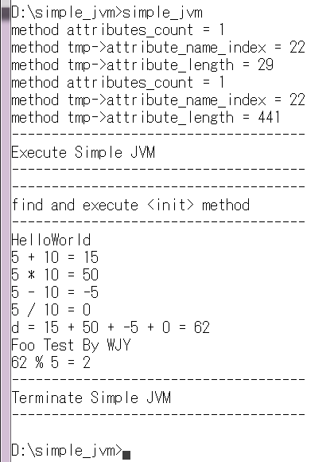
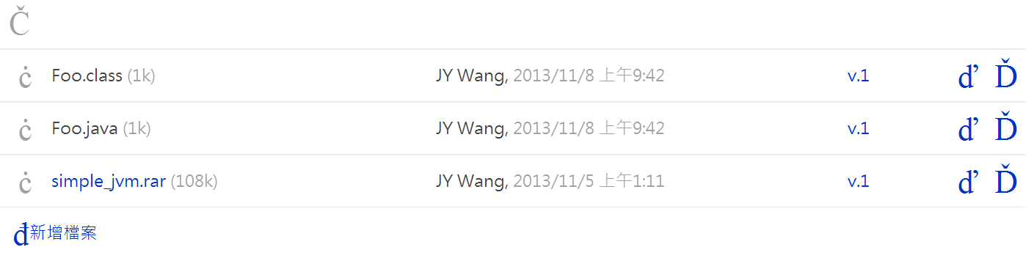
Experiment: add irem instruction into Simple JVM
irem | 0x70 | Pop value1, Pop value2 result = value2 % value1 Push result
goo.gl/xIMuym
Execution Result:

